Slide 1
Dynamic Programming
Chapter 11

Slide 2
11.1 A Prototype Example for Dynamic Programming
The stagecoach驿站马车 problem
Mythical fortune-seeker travels West by stagecoach to join the gold rush in the mid-1900s
The origin and destination is fixed
Many options in choice of route
Insurance policies on stagecoach riders
Cost depended on perceived route safety
Choose safest route by minimizing policy cost

Slide 3
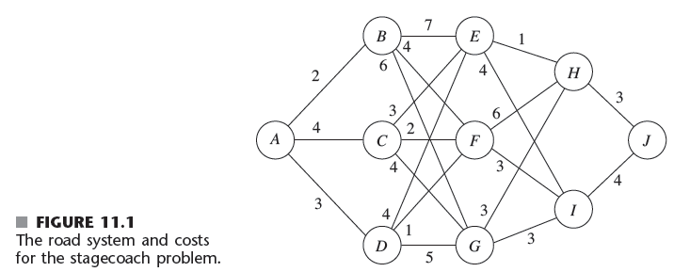
A Prototype Example for Dynamic Programming
Incorrect solution: choose cheapest run offered by each successive stage
Gives A→B → F → I → J for a total cost of 13
There are less expensive options

Slide 4
A Prototype Example for Dynamic Programming
Trial-and-error solution
Very time consuming for large problems
Dynamic programming solution
Starts with a small portion of original problem
Finds optimal solution for this smaller problem
Gradually enlarges the problem
Finds the current optimal solution from the preceding one

Slide 5
A Prototype Example for Dynamic Programming
Stagecoach problem approach
Start when fortune-seeker is only one stagecoach ride away from the destination
Increase by one the number of stages remaining to complete the journey
Problem formulation
Decision variables x₁, x₂, x₃, x₄
Route begins at A, proceeds through x₁, x₂, x₃, x₄, and ends at J

Slide 6
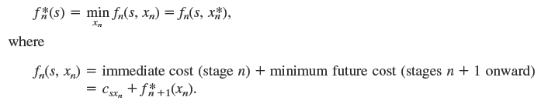
A Prototype Example for Dynamic Programming
Let f_{n}(s, x_{n}) be the total cost of the overall policy for the remaining stages
Fortune-seeker is in state s, ready to start stage n
Selects x_{n} as the immediate destination
Value of c_{sxn} obtained by setting i = s and j = x_{n}

Slide 7
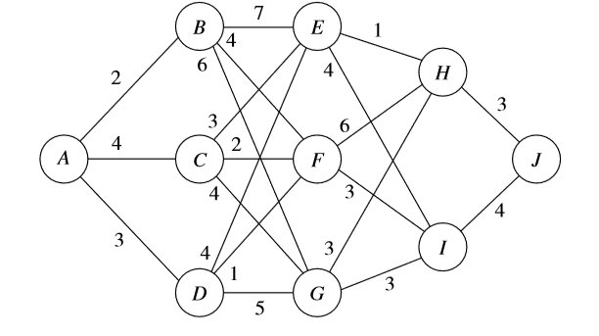

A Prototype Example for Dynamic Programming

Slide 8
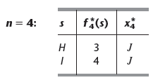
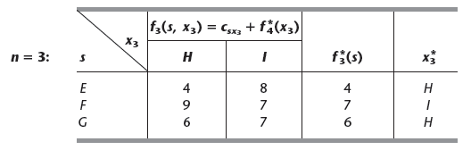
A Prototype Example for Dynamic Programming
Immediate solution to the n = 4 problem
When n = 3:

Slide 9
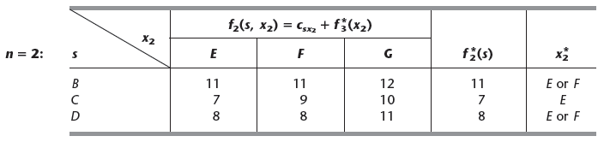
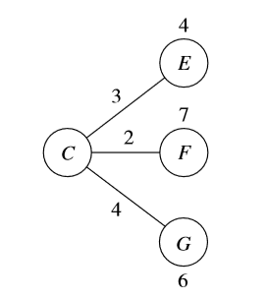
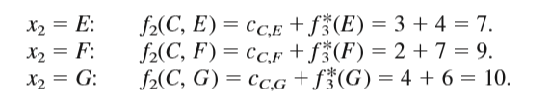
A Prototype Example for Dynamic Programming
The n = 2 problem

Slide 10
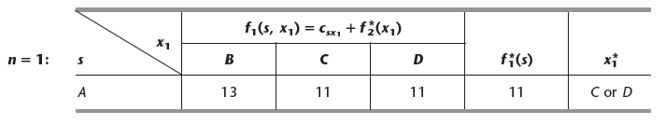
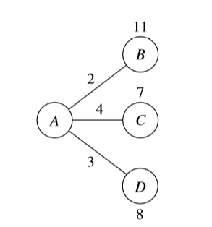
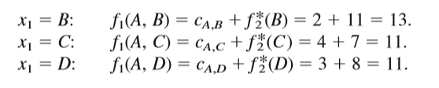
A Prototype Example for Dynamic Programming
When n = 1:

Slide 11
A Prototype Example for Dynamic Programming
Construct optimal solution using the four tables
Results for n = 1 problem show that fortune-seeker should choose state C or D
Suppose C is chosen
For n = 2, the result for s = C is x₂*=E …
One optimal solution: A→ C → E → H → J
Suppose D is chosen instead
A → D → E → H → J and A → D → F → I → J

Slide 12
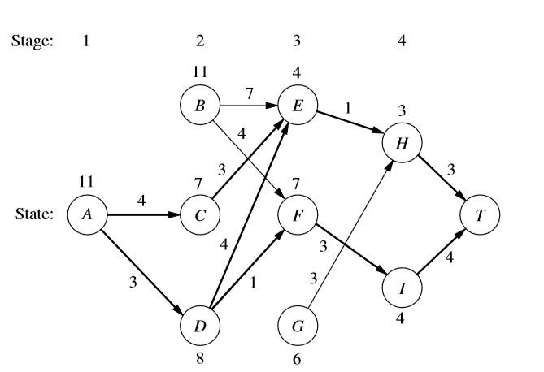
A Prototype Example for Dynamic Programming
All three optimal solutions have a total cost of 11

Slide 13
11.2 Characteristics of Dynamic Programming Problems
The stagecoach problem is a literal prototype
Provides a physical interpretation of an abstract structure
Features of dynamic programming problems
Problem can be divided into stages with a policy decision required at each stage
Each stage has a number of states associated with the beginning of the stage （The number of states may be either finite or infinite ）

Slide 14

Characteristics of Dynamic Programming Problems
Features (cont’d.)
The policy decision at each stage transforms the current state into a state associated with the beginning of the next stage
Solution procedure designed to find an optimal policy for the overall problem
Given the current state, an optimal policy for the remaining stages is independent of the policy decisions of previous stages

Slide 15
Characteristics of Dynamic Programming Problems
Features (cont’d.)
The solution procedure begins by finding the optimal policy for the last stage
A recursive relationship 递推that identifies the optimal policy for stage n, given the optimal policy for stage n + 1, is available

Slide 16
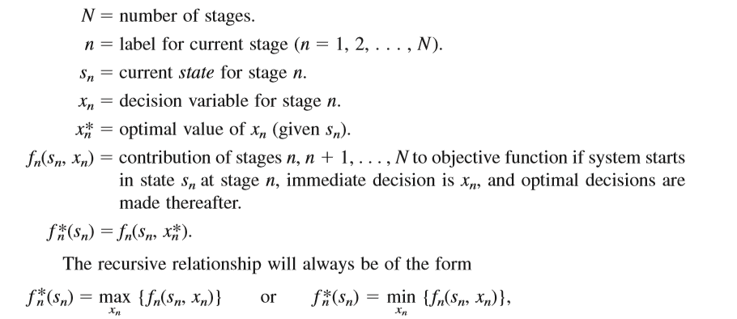
Characteristics of Dynamic Programming Problems
Recursive relationship

Slide 17
Characteristics of Dynamic Programming Problems
Features (cont’d.)
When we use this recursive relationship, the solution procedure starts at the end and moves backward stage by stage

Slide 18
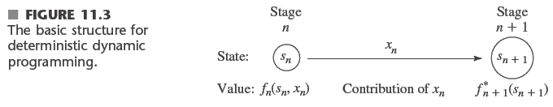
11.3 Deterministic Dynamic Programming
Deterministic 确定性problems
The state at the next stage is completely determined by the current stage and the policy decision at that stage

Slide 19
Deterministic Dynamic Programming
Categorize dynamic programming by form of the objective function
Minimize sum of contributions of the individual stages
Or maximize a sum, or minimize a product of the terms
Nature of the states
Discrete 离散的or continuous state variable/state vector
Nature of the decision variables
Discrete or continuous

Slide 20
Deterministic Dynamic Programming
Example 2: distributing medical teams to countries
Problem: determine how many of five available medical teams to allocate to each of three countries
The goal is to maximize teams’ effectiveness
Performance measured in terms of increased life expectancy

Slide 21
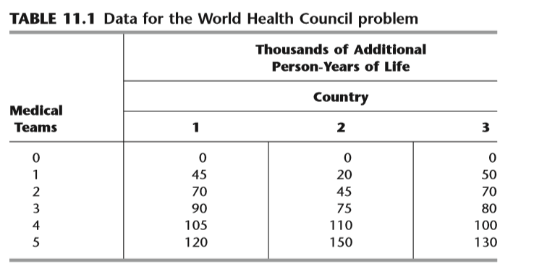
Deterministic Dynamic Programming
Formulation: this problem requires making three interrelated decisions, namely, how many medical teams to allocate to each of the three countries. Therefore, even though there is no fixed sequence, these three countries can be considered as the three stages in a dynamic programming formulation.

Slide 22
(1)Stage: n=1,2,3
(2)Decision variables: x_{n} ----are the number of teams to allocate to stage n.
(3)State: The identification of the states may not be readily apparent. To determine the states, we ask questions such as the following. What is it that changes from one stage to the next? Given that the decisions have been made at the previous stages, how can the status of the situation at the current stage be described? What information about the current state of affairs is necessary to determine the optimal policy hereafter? On these bases, an appropriate choice for the “state of the system” is
S_{n}-----number of medical teams still available for allocation to remaining countries
S₁=5, S₂=5-x₁=S₁-x₁, S3=S₂-x₂

Slide 23

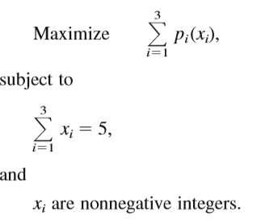
(4) Decision effect: p_{i}(x_{i})----the measure of performance from allocating x_{i} medical teams to country i, its value is in table10.1.
(5)Recursive relationship:
Solution procedure:
Method 1: solve with graphic method.

Slide 24
0
0
0
20
1
0
1
0
45
20
2
0
50
120
2
105
75
45
70
90
20
70
3
0
0
5
3
80
75
110
45
45
20
100
0
4
0
75
4
110
130
150
45
20
5
0
5

Slide 25
Method 2: solve in algebraic method.
Beginning with the last stage
When n=3
s₃ | f₃*(s₃) | x₃*
0 1 2 3 4 5 | 0 50 70 80 100 130 | 0 1 2 3 4 5

Slide 26
When n=2
S₂=0, x₂=0, s₃=0
S₂=1,

Slide 27
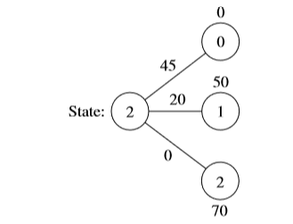
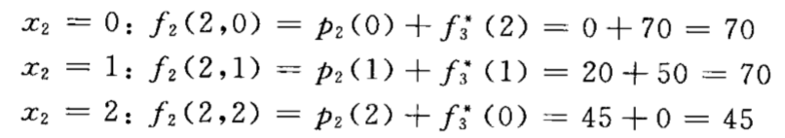
When n=2
S₂=2

Slide 28
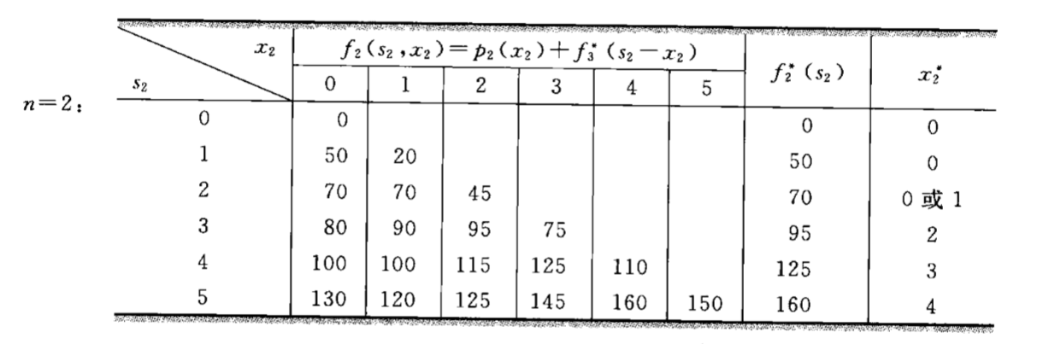

Slide 29
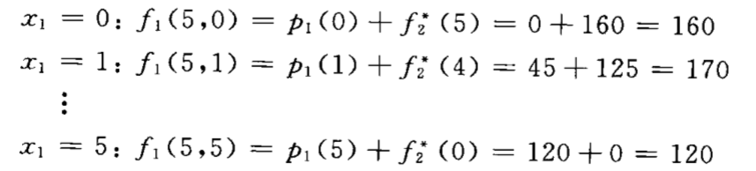
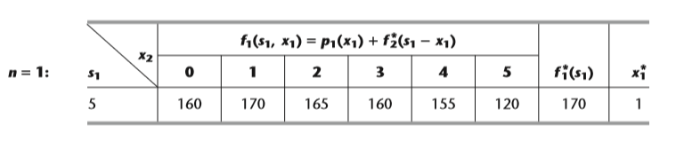

Slide 30
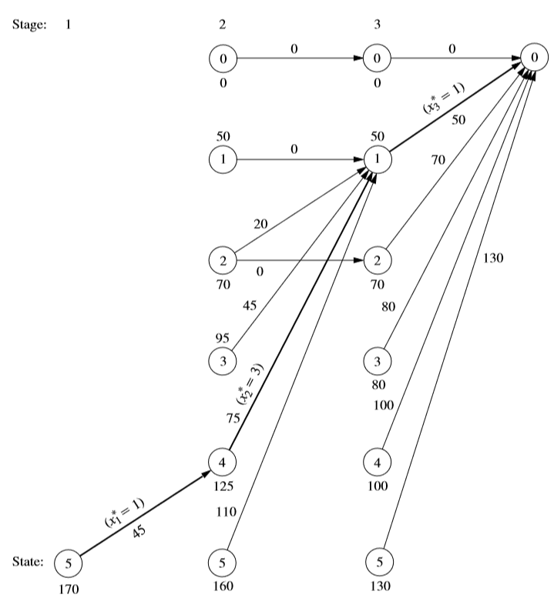

Slide 31
Deterministic Dynamic Programming
Distribution of effort problem工作分配问题
Medical teams example is of this type
Differences from linear programming
Four assumptions of linear programming (proportionality, additivity, divisibility, and certainty) need not apply
Only assumption needed is additivity
Example 3: distributing scientists to research teams

Slide 32
Deterministic Dynamic Programming
Example 4: scheduling employment levels
State variable is continuous
Not restricted to integer values

Slide 33
11.4 Probabilistic Dynamic Programming
Different from deterministic dynamic programming
Next state is not completely determined by state and policy decisions at the current stage
Probability distribution describes what the next state will be
Decision tree

Slide 34
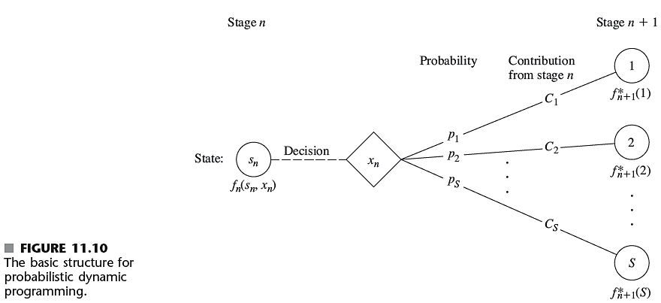
Probabilistic Dynamic Programming

Slide 35
Probabilistic Dynamic Programming
A general objective
Minimize the expected sum of the contributions from the individual stages
Problem formulation
f_{n}(s_{n}, x_{n}) represents the minimum expected sum from stage n onward
State and policy decision at stage n are s_{n} and x_{n}, respectively

Slide 36
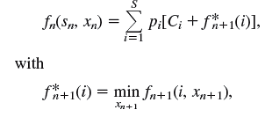
Probabilistic Dynamic Programming
Problem formulation
Example 5: determining reject allowances

Slide 37
Probabilistic Dynamic Programming
Example 6: winning in Las Vegas
Statistician has a procedure that she believes will win a popular Las Vegas game
67% chance of winning a given play of the game
Colleagues bet that she will not have at least five chips after three plays of the game
If she begins with three chips
Assuming she is correct, determine optimal policy of how many chips to bet at each play
Taking into account results of earlier plays

Slide 38
Probabilistic Dynamic Programming
Objective: maximize probability of winning her bet with her colleagues
Dynamic programming problem formulation
Stage n: n^{th} play of game (n = 1, 2, 3)
x_{n}: number of chips 筹码数to bet at stage n
State s_{n}: number of chips in hand to begin stage n

Slide 39
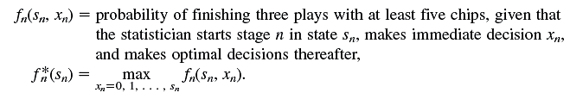
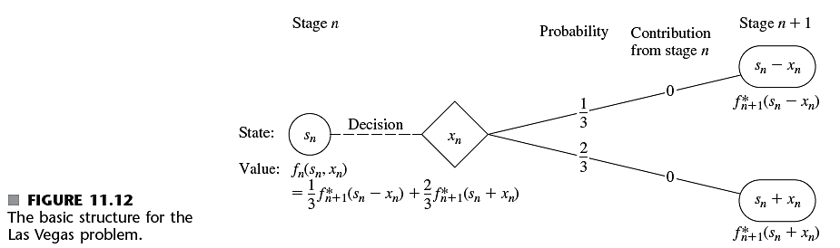
Probabilistic Dynamic Programming
Problem formulation (cont’d.)

Slide 40
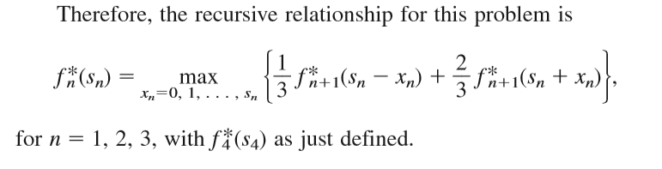
Probabilistic Dynamic Programming
Problem formulation (cont’d.)

Slide 41
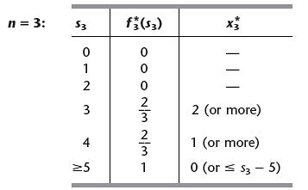
Probabilistic Dynamic Programming
Solution

Slide 42
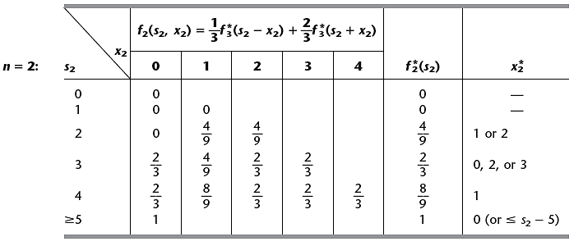
Probabilistic Dynamic Programming
Solution (cont’d.)

Slide 43
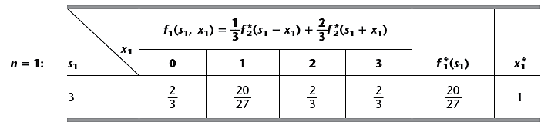
Probabilistic Dynamic Programming
Solution (cont’d.)

Slide 44
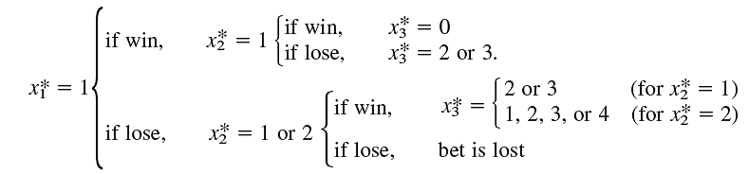
Probabilistic Dynamic Programming
Solution (cont’d.)
From the tables, the optimal policy is:
Statistician has a 20/27 probability of winning the bet with her colleagues

Slide 45
11.5 Conclusions
Dynamic programming
Useful technique for making a sequence of interrelated decisions
Requires forming a recursive relationship
Provides great computational savings for very large problems
This chapter: covers dynamic programming with a finite number of stages
Chapter 19 covers indefinite stages

